Slide 1
Parametric test: Comparing two means – t tests
When you have two groups of data, then you may want to compare the two means that comes from two groups of data.
Two means comes from two groups either expose different people to different experimental manipulations (between group or Independent design) or take a single group of people and expose them to different experimental manipulations (repeated measures design).
Independent design can be tested using independent t – test and repeated measures design can be tested using paired t – test.
Independent t test is used when two data sets are generated when the two sets/group of people are assigned with two different experimental conditions.
Dependent t test is used when the same group of people or same subject of interest is exposed to two different experimental conditions.

Slide 2
Conditions for t tests
Data should be parametric in nature (distribution).
Data should in measured at least in ratio or interval.
Variances exhibited by the data sets should be roughly equal.

Slide 3
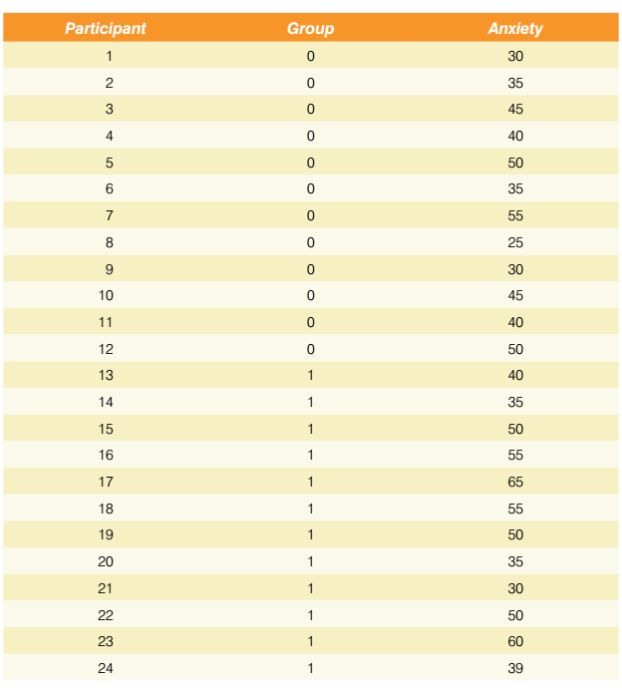
How to perform Independent sample t test
Different participants of 24 so there is no relationship between the picture spider and the real spider so its independent t test. (coded as “0” and “1”).

Slide 4
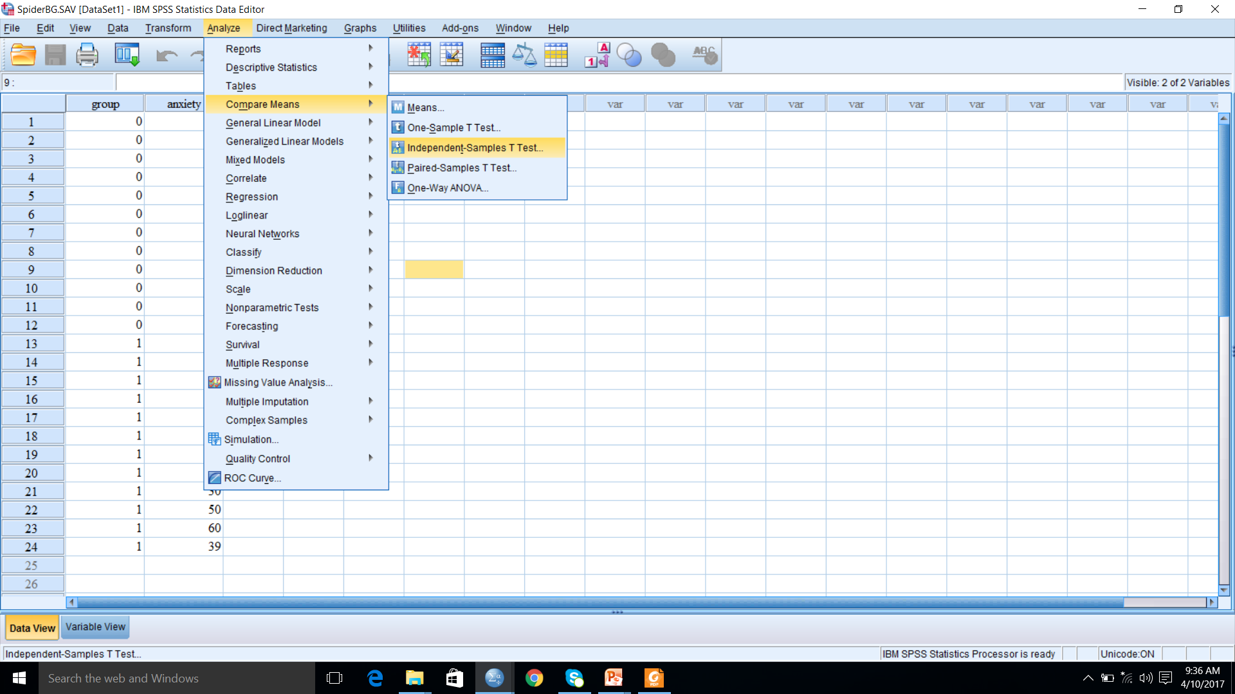
Performing independent t test

Slide 5
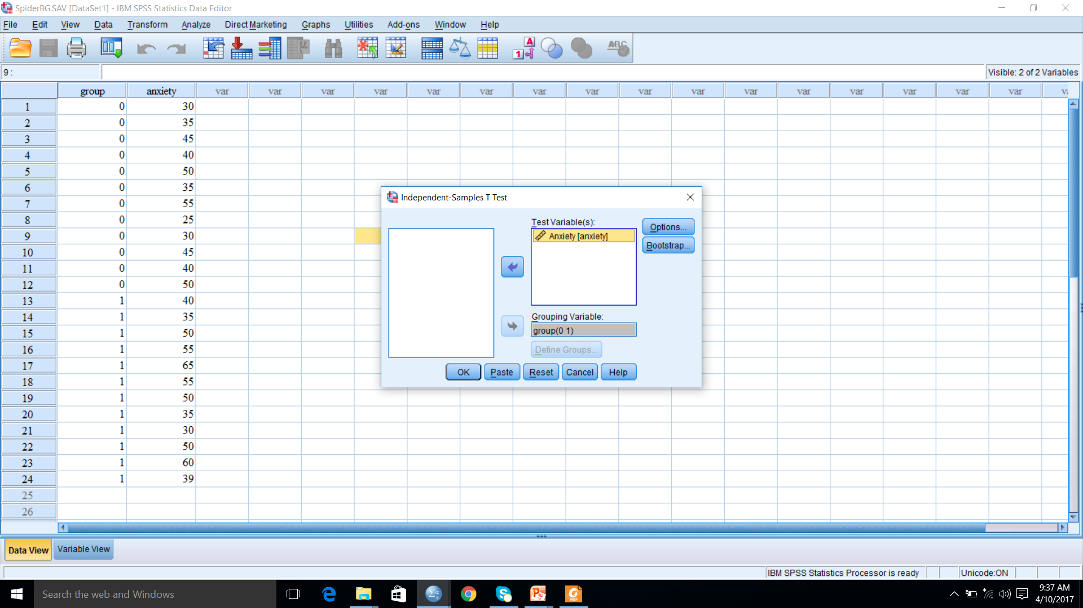
Contd…

Slide 6
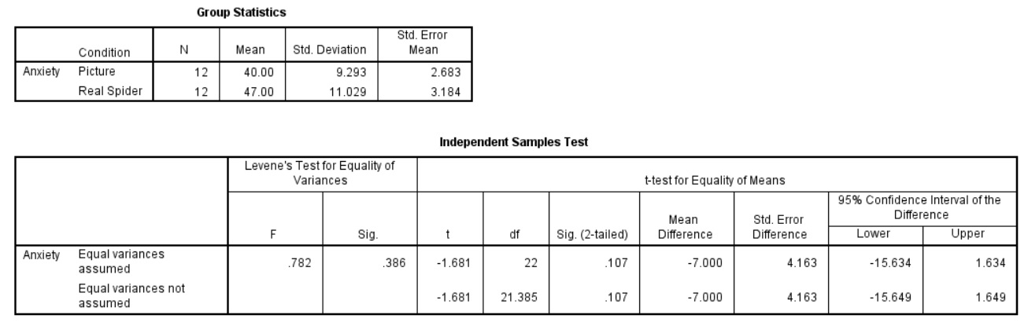
output
The example is whether fear of spiders evokes similar anxiety between the people having seen real spiders and the picture of spiders. Twenty four cases were taken. Twelve were asked to play with a big hairy spider having big fangs and an evil looks. Their subsequent anxiety was measured. The other twelve were shown only pictures of the same big hairy spiders and their anxiety was measured

Slide 7

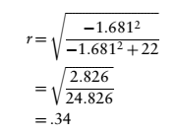
Calculating effect size
To know whether the effect is substantive we can convert the t-statistics into a value of r using the formula. We know the value of t and the df from the SPSS output and so we can compute r as follows:

Slide 8
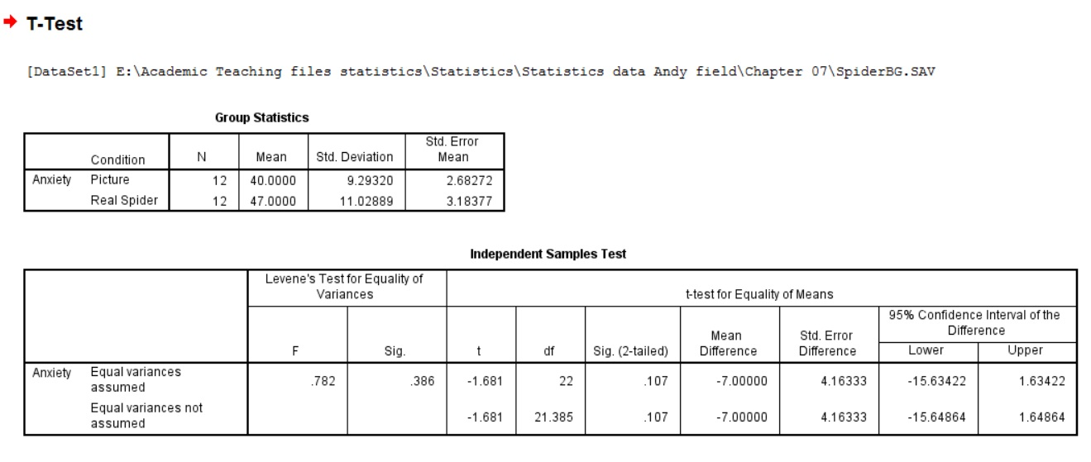
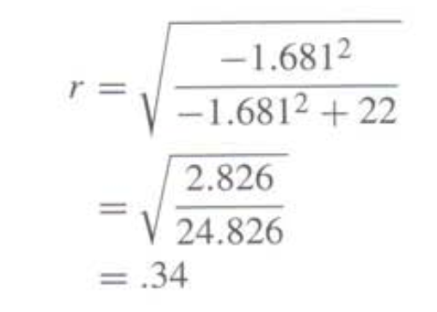
Output: Look at levene’s test. If the levene’s test is less than .05 then look into the statistic of “Equal variances not assumed” row and if the Levene’s test is greater than .05 then look into the statistic “Equal variances assumed” row.
Calculating effect size

Slide 9
Reporting t test result (Independent t test)
On average, participants experienced greater anxiety to real spiders (M = 47.00, SE = 3.18) than to pictures of spiders (M = 40.00, SE = 2.68). This difference was not significant t(22) = -1.68, p > .05; however, it did represent a medium-sized effect r = .34.

Slide 10
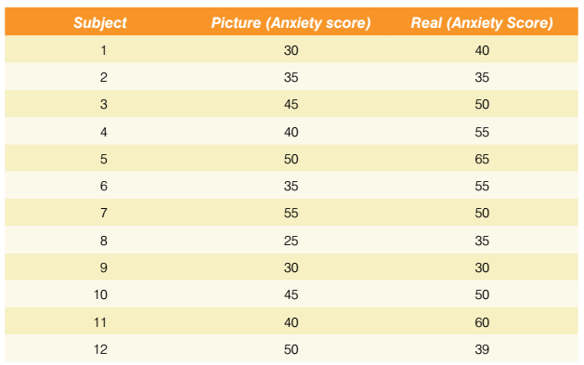
Dependent t test (data arrangement)

Slide 11
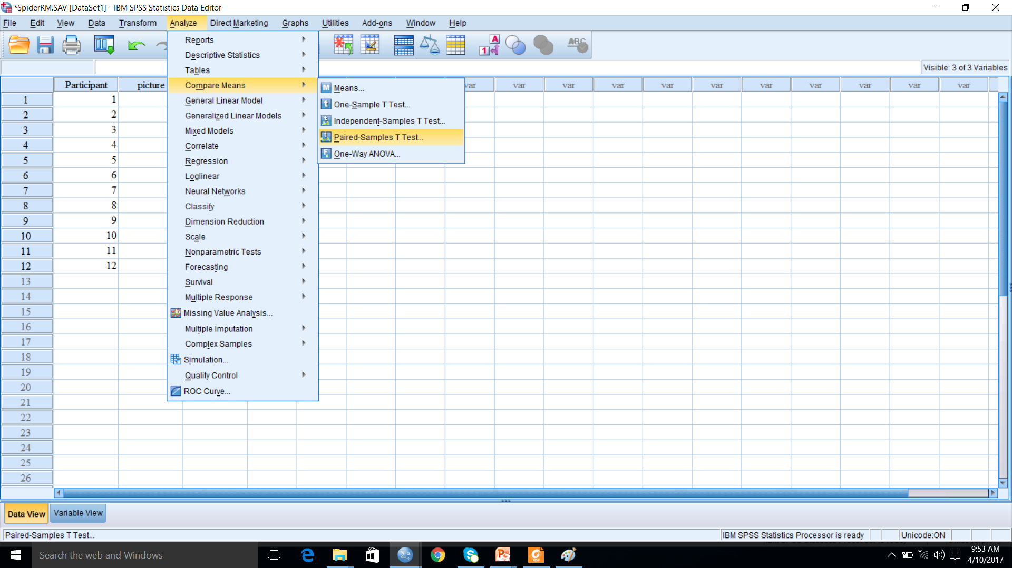
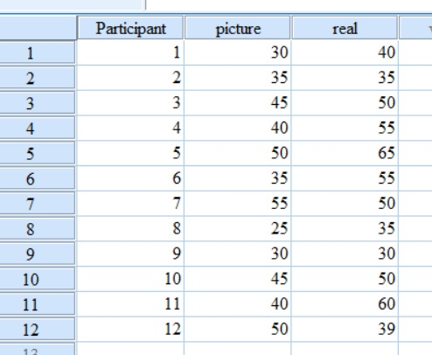
Dependent t test

Slide 12
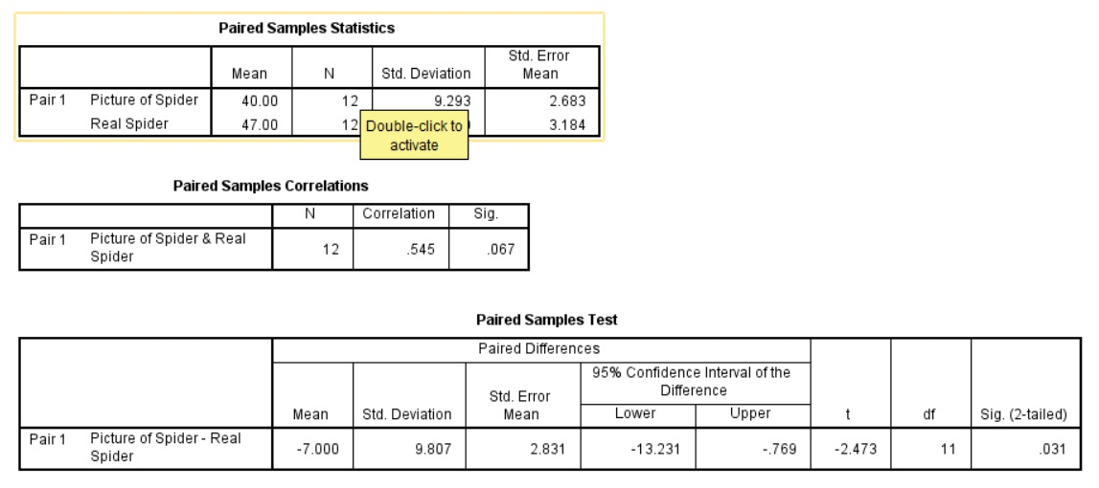
Out put from dependent t test

Slide 13
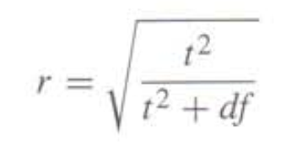
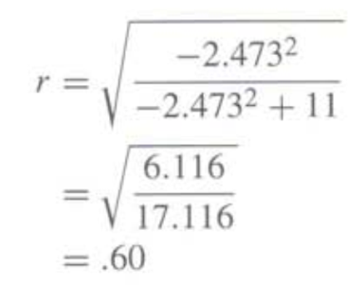
Calculating the effect size
Converting the t value into r value:
Reporting result of dependent t test
On average, participants experienced significantly greater anxiety to real spiders (M = 47.00, SE = 3.18) than to pictures of spiders (M = 40.00, SE = 2.68), t(11) = –2.47, p < .05, r = .60.

Slide 14
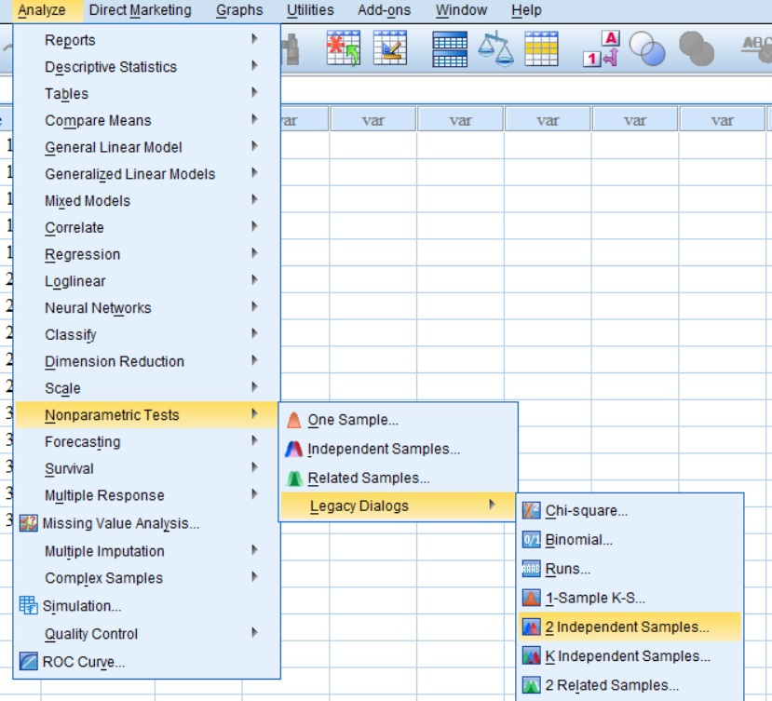
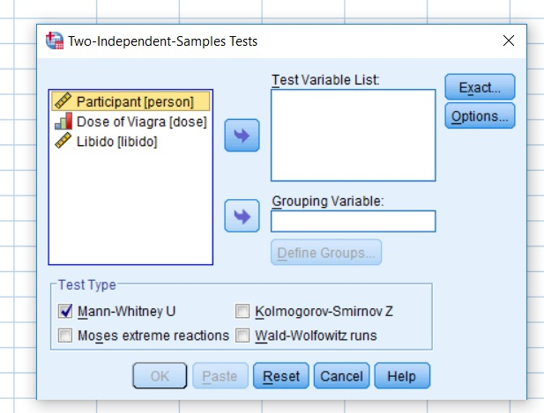
What to do if the data exhibits non normal distribution?
If you have only two samples and if they are independent sample, check Mann Whitney and interpret the output

Slide 15
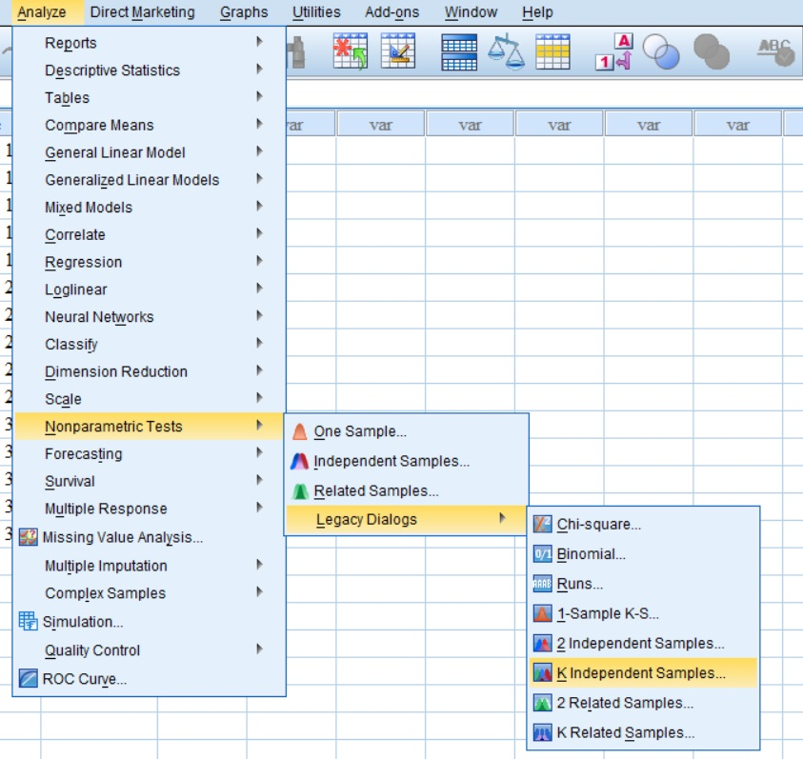
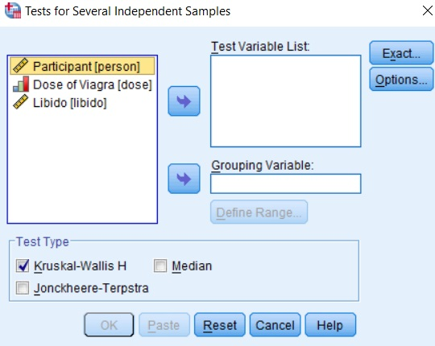
If you have more than two samples and if they are independent sample, check Kruskal Wallis and interpret the output
Similarly if you have two related (dependent) samples check Wilcoxon and interpret the output and the sample is more than two and are related samples then check k related (independent) samples and interpret the output

